Slide 1
Population and Sample
Population
  Totality of the observations with which we are concerned
Sample
  A subset of population

Slide 2
Parameter and Statistic
Parameter
  Any numerical value describing a characteristic of a population
Statistic
  Any numerical value describing a characteristic of a sample

Slide 3
Measures of Central Tendency

Slide 4
Measures of Central Tendency
or
Measures of Location
or
Measures of Averages

Slide 5
Measures of Central Tendency
A measure of central tendency is a descriptive statistic that describes the average, or typical value of a set of scores
There are three common measures of central tendency:
  the mode
  the median
  the mean

Slide 6
Descriptive Statistics
The goal of descriptive statistics is to summarize a collection of data in a clear and understandable way.

Slide 7
Central Tendency
Measure of Central Tendency:
  A single summary score that best describes the central location of an entire distribution of scores.
    The typical score.
    The center of the distribution.
  One distribution can have multiple locations where scores cluster.
    Must decide which measure is best for a given situation.

Slide 8
Central Tendency
Measures of Central Tendency:
  Mean
    The sum of all scores divided by the number of scores.
  Median
    The value that divides the distribution in half when observations are ordered.
  Mode
    The most frequent score.

Slide 9
MEAN

Slide 10
Measure of central tendency
Arithmetic Mean (Mean)
Definition:
Sum of all the observation s divided by the number of the observations
The arithmetic mean is the most common measure of the central location of a sample.

Slide 11
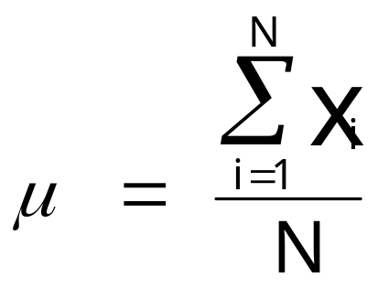
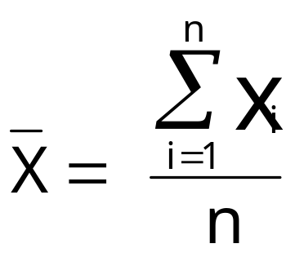
The Mean
The mean of a population is represented by the Greek letter μ; the mean of a sample is represented by X
Population
Sample

Slide 12
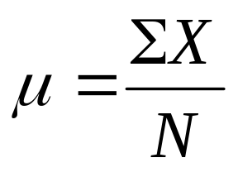
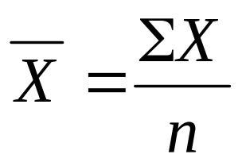
The Mean
“sigma”, the sum of X, add up all scores
Population
Sample
“mu”
“N”, the total number of scores in a population
“sigma”, the sum of X, add up all scores
“X bar”
“n”, the total number of scores in a sample

Slide 13
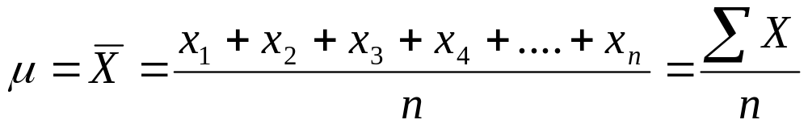
Mean formula:

Slide 14
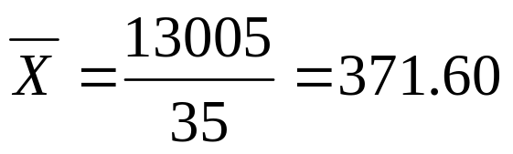
Calculating Mean
52, 76, 100, 136, 186, 196, 205, 150, 257, 264, 264, 280, 282, 283, 303, 313, 317, 317, 325, 373, 384, 384, 400, 402, 417, 422, 472, 480, 643, 693, 732, 749, 750, 791, 891
Mean hotel rate:
  Mean hotel rate: $371.60

Slide 15
Mean affected by extreme values
0 1 2 3 4 5 6 7 8 9 10
0 1 2 3 4 5 6 7 8 9 10 12 14
Mean = 5
Mean = 6

Slide 16
When To Use the Mean
You should use the mean when
  the data are interval or ratio scaled
    Many people use the mean with ordinally scaled data too
  and the data are not skewed
The mean is preferred because it is sensitive to every score
  If you change one score in the data set, the mean will change

Slide 17
Pros and Cons of the Mean
Pros
  Mathematical center of a distribution.
  Good for interval and ratio data.
  Does not ignore any information.
  Inferential statistics is based on mathematical properties of the mean.
  It is unique - there is only one answer.
  Useful when comparing sets of data.
Cons
  Influenced by extreme scores and skewed distributions.

Slide 18
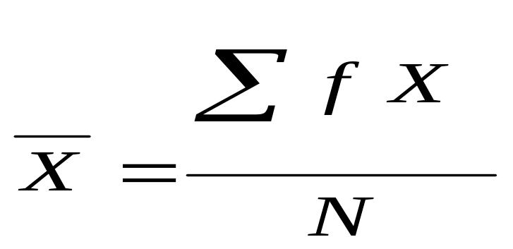

Mean for Grouped Data
where: f X = a score multiplied by its frequency

Slide 19
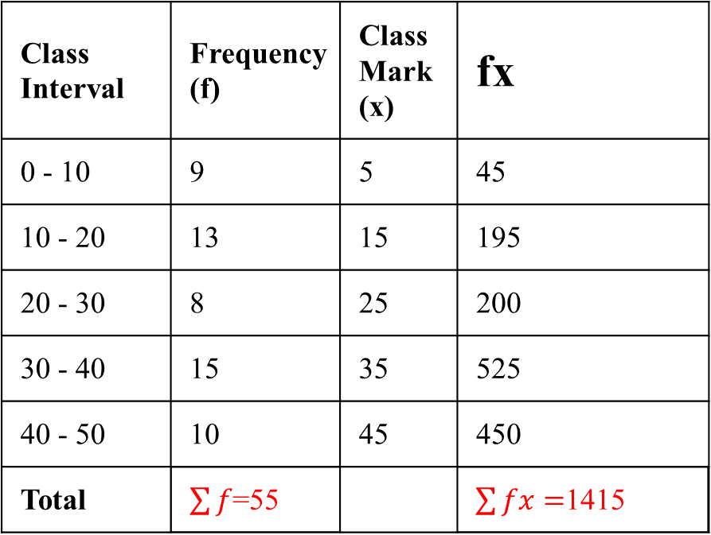
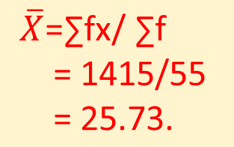
Calculating the Mean for Grouped Data

Slide 20
Calculating the Mean for Grouped Data
Class Interval | 10-25 | 25-40 | 40-55 | 55-70 | 70-85 | 85-100
Number of Students | 2 | 3 | 7 | 6 | 6 | 6

Slide 21
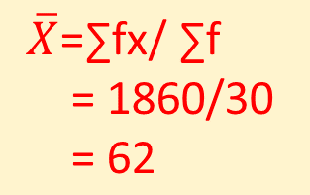
Calculating the Mean for Grouped Data
Class Interval | Number of students (f_{i}) | Class Mark (x_{i}) | f_{i}x_{i}
10-25 | 2 | 17.5 | 35
25-40 | 3 | 32.5 | 97.5
40-55 | 7 | 47.5 | 332.5
55-70 | 6 | 62.5 | 375
70-85 | 6 | 77.5 | 465
85-100 | 6 | 92.5 | 555
Total | Σf_{i} = 30 |  | Σf_{i}x_{i} = 1860

Slide 22
Weighted Mean
A weighted mean is a kind of average. Instead of each data point contributing equally to the final mean, some data points contribute more “weight” than others. If all the weights are equal, then the weighted mean equals the arithmetic mean.Weighted means are very common in statistics, especially when studying populations.

Slide 23
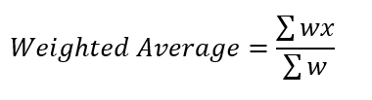

Weighted Mean

Slide 24
Weighted Average
For example, use a weighted average in the following situations:
  A professor weights projects, exams, and quizzes to reflect varying difficulty.
  An investor weights the share price by the number of stocks they purchase to reflect the changing prices.
A weighted average gives differing importance to each value according to relevant criteria.

Slide 25

Weighted Mean

Slide 26
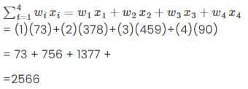


Weighted Mean

Slide 27
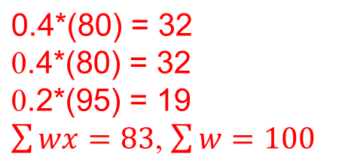

Example
You take three 100-point exams in your statistics class and score 80, 80 and 95. The last exam is much easier than the first two, so your professor has given it less weight. The weights for the three exams are:
Exam 1: 40 % of your grade.
Exam 2: 40 % of your grade.
Exam 3: 20 % of your grade.
What is your final weighted average for the class?

Slide 28
MEDIAN

Slide 29
The Median
The word median is synonymous with “middle,” and the sample median is indeed the middle value once the observations are ordered from smallest to largest.
It is the score in the middle; half of the scores are larger than the median and half of the scores are smaller than the median

Slide 30
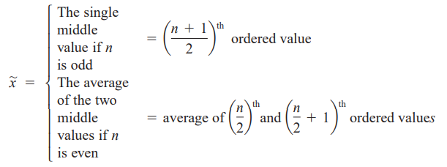
The Median
The sample median is obtained by first ordering the n observations from smallest to largest (with any repeated values included so that every sample observation appears in the ordered list).
Then,

Slide 31


The Median

Slide 32
How To Calculate the Median
Conceptually, it is easy to calculate the median
  There are many minor problems that can occur; it is best to let a computer do it
Sort the data from highest to lowest
Find the score in the middle
  middle = (N + 1) / 2
  If N, the number of scores, is even the median is the average of the middle two scores

Slide 33
Median Example
What is the median of the following scores:
10 8 14 15 7 3 3 8 12 10 9
Sort the scores:
3 3 7 8 8 9 10 10 12 14 15
Determine the middle score:
n is odd = (N + 1) / 2 = (11 + 1) / 2 = 6
Middle score = median = 9

Slide 34
Median Example
What is the median of the following scores:
24 18 19 42 16 12
Sort the scores:
12 16 18 19 24 42
Determine the middle score:
n is even: = (N/2) = (6/ 2) = 3
= (N/2) = (6/ 2 +1) = 3+1 =4
Median = average of 3rd and 4th scores:
(18 + 19) / 2 = 18.5

Slide 35
When To Use the Median
The median is often used when the distribution of scores is either positively or negatively skewed
  The few really large scores (positively skewed) or really small scores (negatively skewed) will not overly influence the median
  Not affected by extreme values
0 1 2 3 4 5 6 7 8 9 10
0 1 2 3 4 5 6 7 8 9 10 12 14
Median = 5
Median = 5

Slide 36
Pros and Cons of Median
Pros
  Not influenced by extreme scores or skewed distributions.
  Good with ordinal data.
  Easier to compute than the mean.
Cons
  May not exist in the data.
  Doesn’t take actual values into account.

Slide 37
MODE

Slide 38
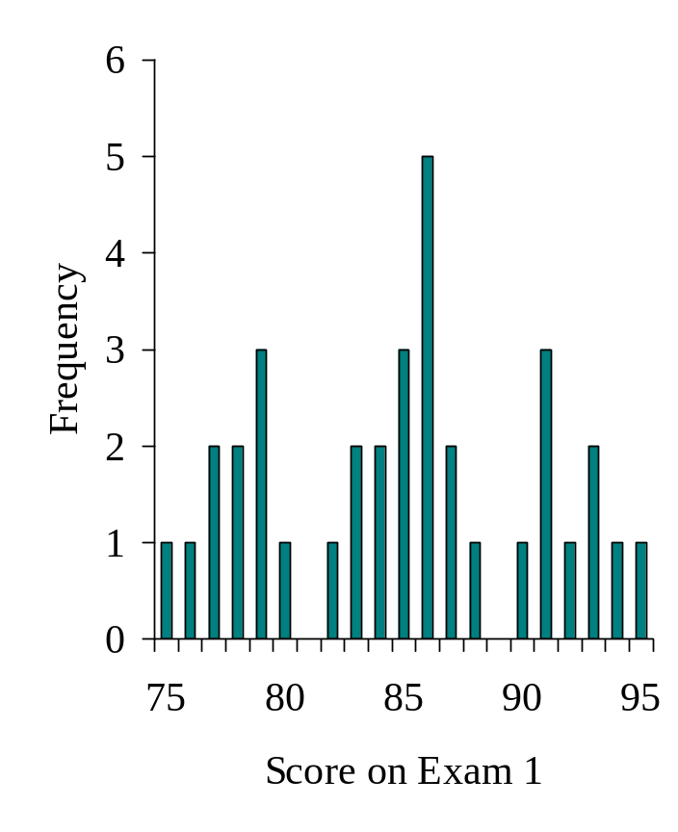
The Mode
The mode is the score that occurs most frequently in a set of data

Slide 39
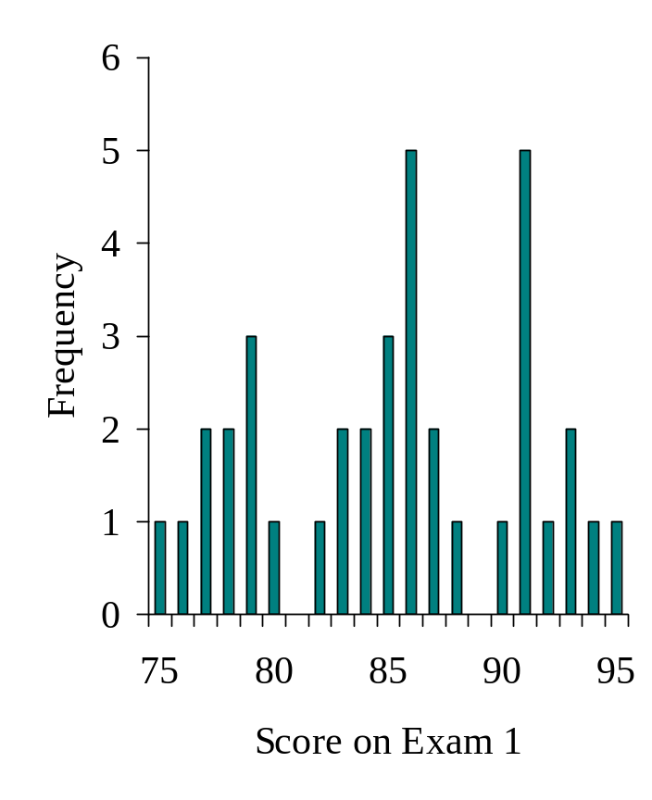
Bimodal Distributions
When a distribution has two “modes,” it is called bimodal

Slide 40


The Mode

Slide 41
Mode
Most frequently occurring value
Data {1,3,7,3,2,3,6,7}
  Mode : 3
Data {1,3,7,3,2,3,6,7,1,1}
  Mode : 1,3
Data {1,3,7,0,2,-3, 6,5,-1}
  Mode : none

Slide 42
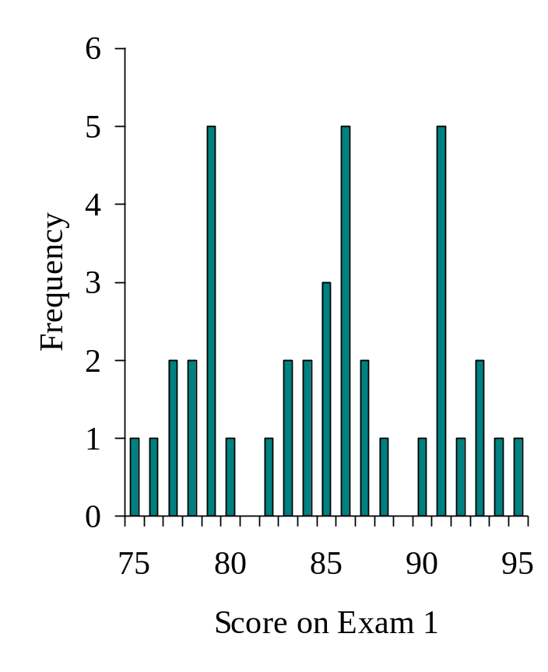
Multimodal Distributions
If a distribution has more than 2 “modes,” it is called multimodal

Slide 43
Central Tendency Example: Mode
52, 76, 100, 136, 186, 196, 205, 150, 257, 264, 264, 280, 282, 283, 303, 313, 317, 317, 325, 373, 384, 384, 400, 402, 417, 422, 472, 480, 643, 693, 732, 749, 750, 791, 891
Mode: most frequent observation
Mode(s) for hotel rates:
  264, 317, 384

Slide 44
The Mode
The mode is the score that occurs most frequently in a set of data
Not Affected by Extreme Values
There May Not be a Mode
There May be Several Modes
Used for non-numerical or categorical data
0 1 2 3 4 5 6 7 8 9 10 11 12 13 14
0 1 2 3 4 5 6
No Mode
Mode = 9

Slide 45
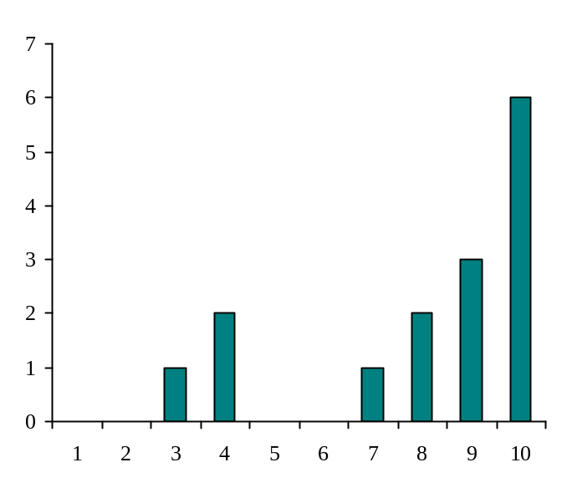
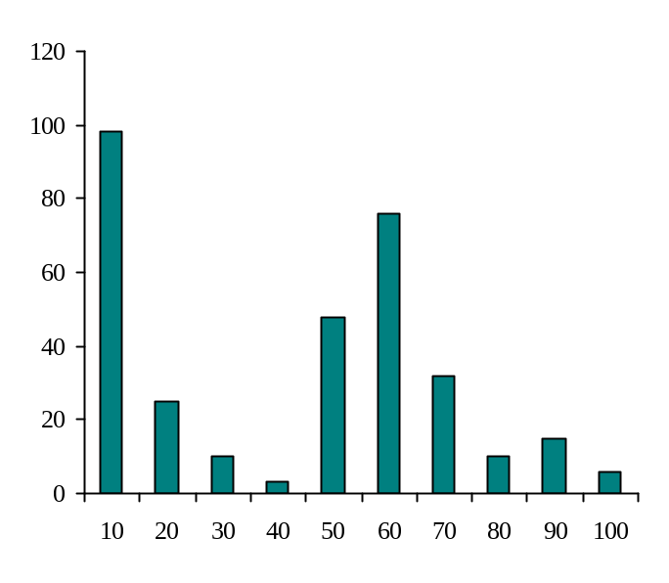
When To Use the Mode
The mode is not a very useful measure of central tendency
  It is insensitive to large changes in the data set
    That is, two data sets that are very different from each other can have the same mode

Slide 46
When To Use the Mode
When there is more than one mode, it is difficult to interpret and/or compare.
The mode is primarily used with nominally scaled data
  It is the only measure of central tendency that is appropriate for nominally scaled data

Slide 47
Pros and Cons of the Mode
Pros
  Good for nominal data.
  Easiest to compute and understand.
  The score comes from the data set.
Cons
  Ignores most of the information in a distribution.
  Small samples may not have a mode.

Slide 48
Example: Central Location
Suppose the age in years of the first 10 patients enrolled in your study are: 34, 24, 56, 52, 21, 44, 64, 34, 42, 46
Then the mean age of this group
is 41.7 years
To find the median, first order the data:
21, 24, 34, 34, 42, 44, 46, 52, 56, 64
The median is (42 +44)/2 = 43 years
The mode
is 34 years.

Slide 49
Suppose the next patient enrolls and their age is 97 years.
How does the mean, median and mode change?
Then the mean age of this group
is 46.7 years
To find the median, first order the data:
21, 24, 34, 34, 42, 44, 46, 52, 56, 64, 97
The median is 44 years
The mode
is 34 years.

Slide 50
Relations Between the Measures of Central Tendency
Mean
Mode
Mean
Median
Mode
Mode
Mean
Median
Median
Negatively
Skewed
Symmetric
(Not Skewed)
Positively
Skewed

Slide 51
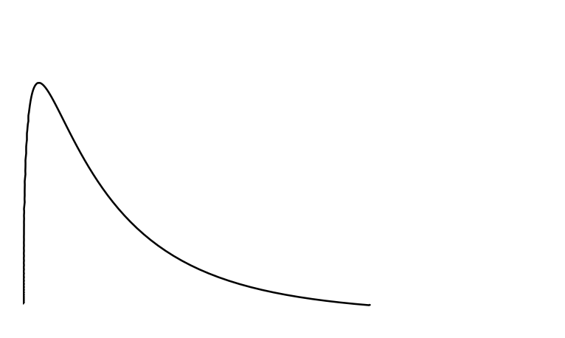
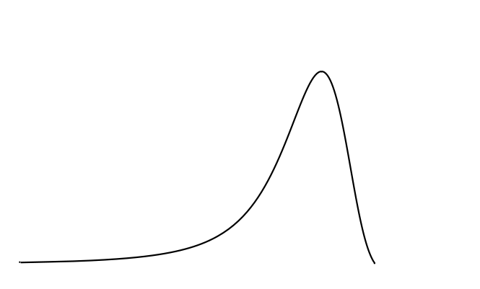
Relations Between the Measures of Central Tendency
In symmetrical distributions, the median and mean are equal
  For normal distributions, mean = median = mode
In positively skewed distributions, the mean is greater than the median
In negatively skewed distributions, the mean is smaller than the median

Slide 52
Comparison of
Central Tendency Measures
Use Mean when distribution is reasonably symmetrical, with few extreme scores and has one mode.
Use Median with nonsymmetrical distributions because it is not sensitive to skewness.
Use Mode when dealing with frequency distribution for nominal data

Slide 53
Assignment
1.1 (a, b, c)
1.4 (a)
Also find the mode of the data given in Ex 1.1 and 1.4

Slide 54
Assignment
Problem 1 : Wages (in Rs) paid to workers of an organization are given below. Calculate Mean.
Problem 2 : Weekly demand for marine fish (in kg) (x) for 100 families is given below. Calculate Mean.
Wages ( C.I.) | 40-60 | 60-80 | 80-100 | 100-120 | 120-140 | 140-160
No.of workers (freq) | 50 | 80 | 30 | 20 | 50 | 20
X | 1 | 2 | 3 | 4 | 5 | Total
No. of Families (freq) | 20 | 50 | 20 | 5 | 5 | 100

